Slide 1
Hypertrophic Cardiomyopathy in Sarcomere Variant Carriers and Non-Carriers Comparing the clinical course of disease
Christoffer Rasmus Vissing
SHaRe investigator meeting
16 May 2023

Slide 2
Hypertrophic cardiomyopathy

Slide 3


Progression of disease
Heart failure
Arrhythmias
Normal heart
Presymptomatic
Cardiomyopathy
Premature
Death
LA dilation or other subtle abnormalities
Significant LVH
Genetic and/or
environmental vulnerability
Toxic affection

Slide 4
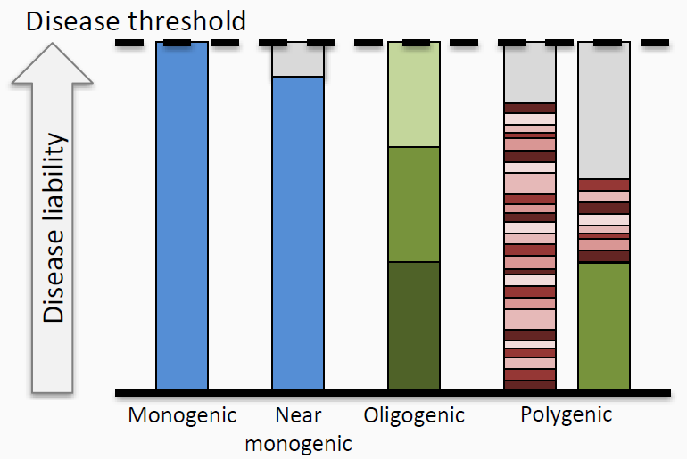
Genetic contribution to disease
LP/P variants in sarcomere genes
“Non-sarcomeric HCM”
Large effect variants (rare)
Intermediate effect variants
Common variants
Environment

Slide 5
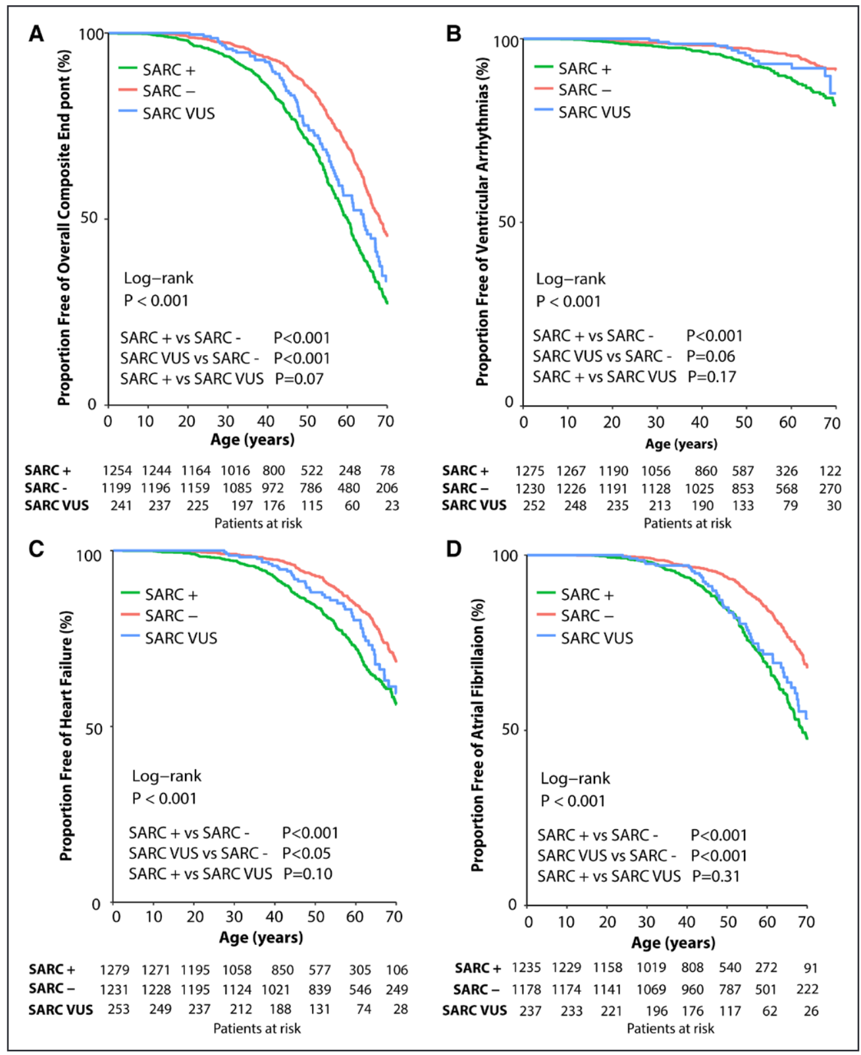

Previously from SHaRe

Slide 6
Hypertrophic Cardiomyopathy in Sarcomere Variant Carriers and Non-Carriers
Research questions
How does prognosis compare during clinical follow-up?
Do these groups represent distinct phenotypes?
Can we identify specific sequences of events
Can we identify low and high risk individuals?
Who to treat
When to treat
How to treat

Slide 7
Agenda
Cardiac co-morbidities and adverse events
Correlations and temporal patterns of CV features
Characteristics of study population
Comparison of mortality

Slide 8
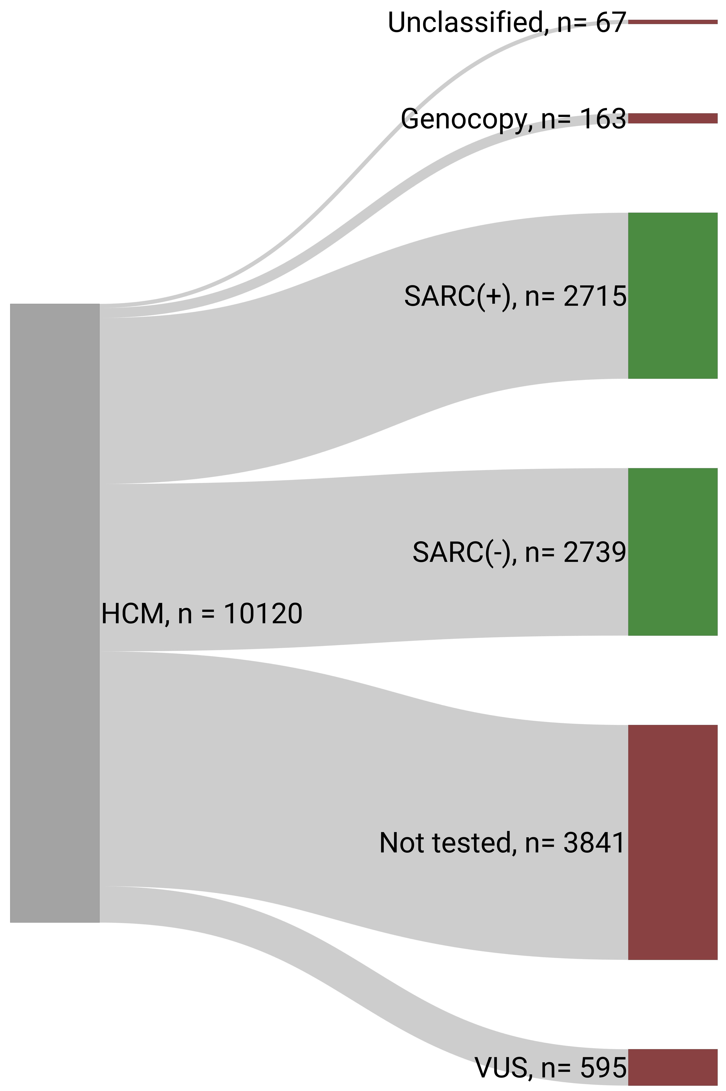
Study Cohort
Characteristics of study population

Slide 9

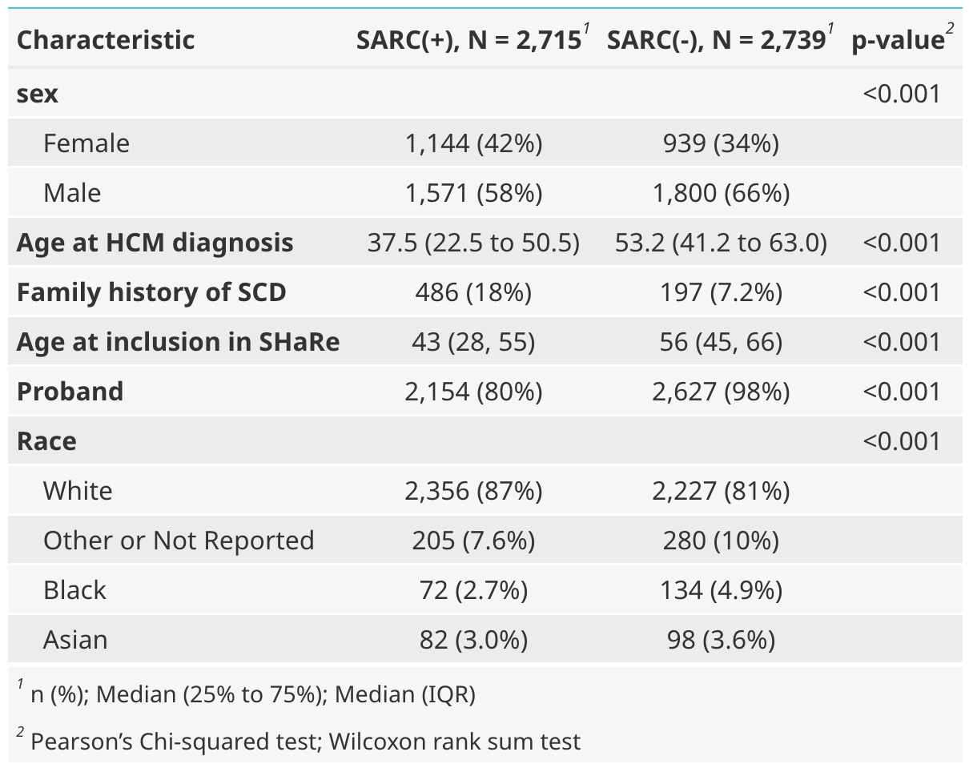
Demographics
Characteristics of study population

Slide 10

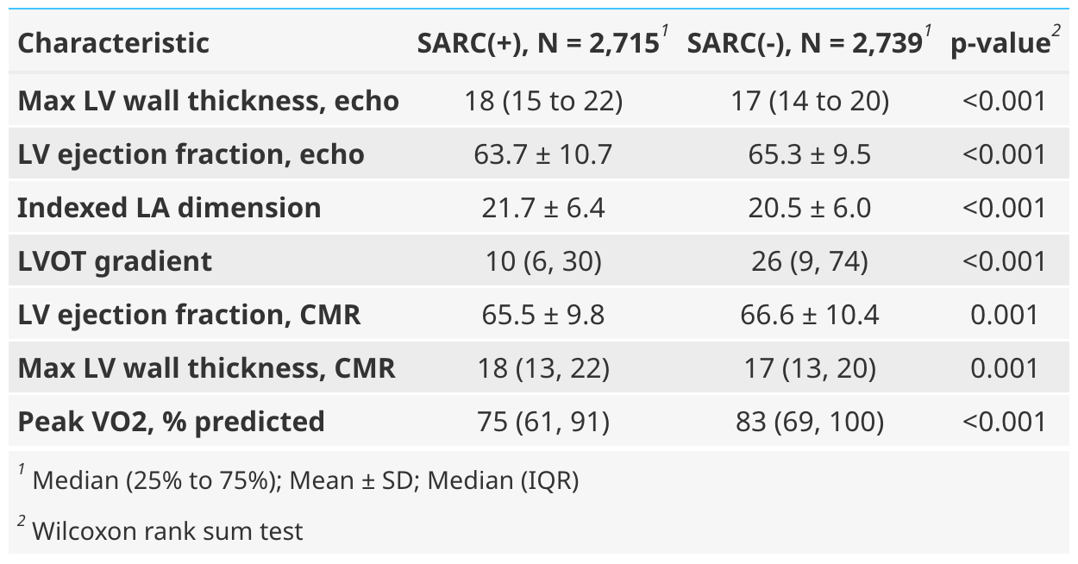
Cardiac function and remodelling
Characteristics of study population

Slide 11
Regression analysis

Slide 12
Summary of characteristics
Sarcomere variants carriers
Younger at HCM onset (by 13 years)
More likely to be female (OR 1.40)
Lower LV ejection fraction (-2.2%-points)
Lower LVOT gradient(-17 mmHg)
Higher LV wall thickness (1.6 mm)
Large left atria (2 mm)
Lower peak oxygen uptake (-2.2 ml O₂/kg/min)

Slide 13
Agenda
Characteristics of study population
Cardiac co-morbidities and adverse events
Correlations and temporal patterns of CV features
Comparison of mortality

Slide 14
Comparing cardiovascular features
Co-morbidities and adverse events

Slide 15
Hypertrophic Cardiomyopathy in Sarcomere Variant Carriers and Non-Carriers
Research questions
How does prognosis compare during clinical follow-up?
Do these groups represent distinct phenotypes?
Can we identify specific sequences of events
Can we identify low and high risk individuals?

Slide 16
LV obstruction
Co-morbidities and adverse events

Slide 17
Atrial fibrillation
Co-morbidities and adverse events

Slide 18
LV systolic dysfunction
Co-morbidities and adverse events

Slide 19
Summary of co-morbidities and events
Non-Sarcomeric HCM
Associated with classic cardiovascular co-morbidities
Associated with CV symptoms and obstructive phenotype
Sarcomeric HCM
Cardiac arrhythmias (all types)
LV systolic dysfunction and HF outcomes
Associated with ”End-stage HCM”-phenotype

Slide 20
Agenda
Characteristics of study population
Cardiac co-morbidities and adverse events
Correlations and temporal patterns of CV features
Comparison of mortality

Slide 21
Hypertrophic Cardiomyopathy in Sarcomere Variant Carriers and Non-Carriers
Research questions
How does prognosis compare during clinical follow-up?
Do these groups represent distinct phenotypes?
Can we identify specific sequences of events
Can we identify low and high risk individuals?

Slide 22
Clinical trajectories
What is the timing of cardiovascular features in the disease course
How likely is the outcome to lead to other outcomes
Correlations and temporal patterns of CV features

Slide 23
Relative timing of cardiac features
Correlations and temporal patterns of CV features

Slide 24
Chronological timing of cardiac features
Correlations and temporal patterns of CV features

Slide 25
Can we identify specific clinical trajectories?
Diagnosis 1 -> Diagnosis 2 -> Diagnosis 3
Correlations and temporal patterns of CV features

Slide 26
Temporal Patterns and Correlations Between Cardiovascular Features
Correlations and temporal patterns of CV features

Slide 27
Summary of Clinical Trajectories
Non-Sarcomeric HCM
Mostly dominated by HTN and Obstruction
HTN and Obstruction aren’t strongly correlated with occurrence of other/additional disease features
Most features occur during early follow-up
Sarcomeric HCM
Cardiac arrhythmias and HF are prevalent
More correlated features (especially for AF)
CV features occur throughout disease-course.

Slide 28
Agenda
Characteristics of study population
Cardiac co-morbidities and adverse events
Correlations and temporal patterns of CV features
Comparison of mortality

Slide 29
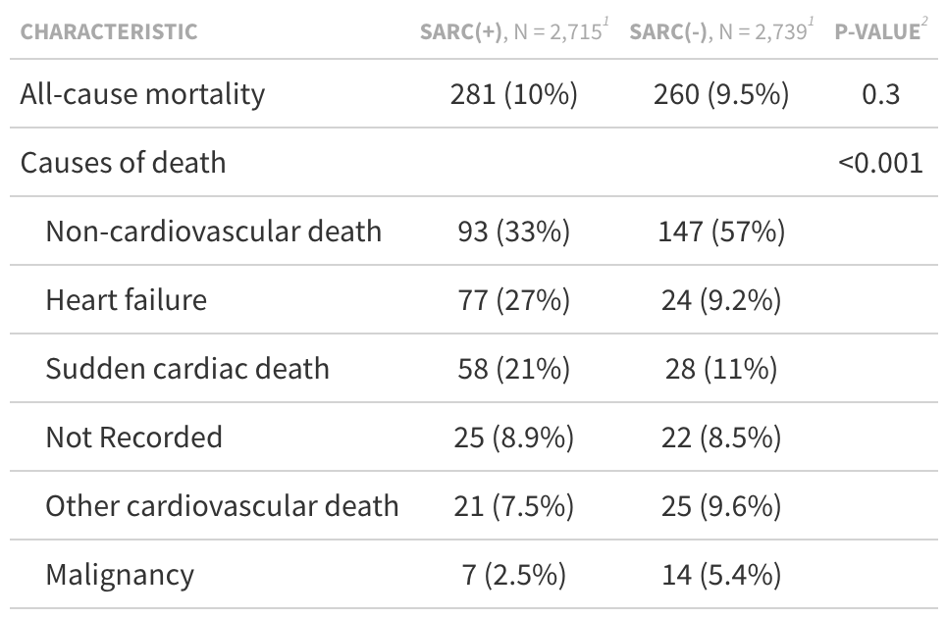
Mortality in Sarcomeric vs Non-sarcomeric HCM
Comparison of mortality

Slide 30
HCM related death
Comparison of mortality

Slide 31
All-cause mortality
Comparison of mortality

Slide 32


Overall Summary
Research questions
Are lifetime differences replicated if measured during clinical follow-up?
Do these groups represent distinct phenotypes?
Can we identify specific sequences of events
Can we identify low and high risk individuals?

Slide 33

Acknowledgements
Rigshospitalet
Henning Bundgaard
Alex Hørby Christensen
Anna Axelsson Raja
Brigham and Womens
Carolyn Y. Ho
Neal Lakdawala
SHaRe
All SHaRe investigators
Funding
Rigshospitalets Forskningspulje
Hjertecentrets Forskningsudvalg
NORDFORSK (PM-Heart)
Fonden af 1. december 1997
Danish Cardiovascular Academy
Carolyn Ho

Slide 35
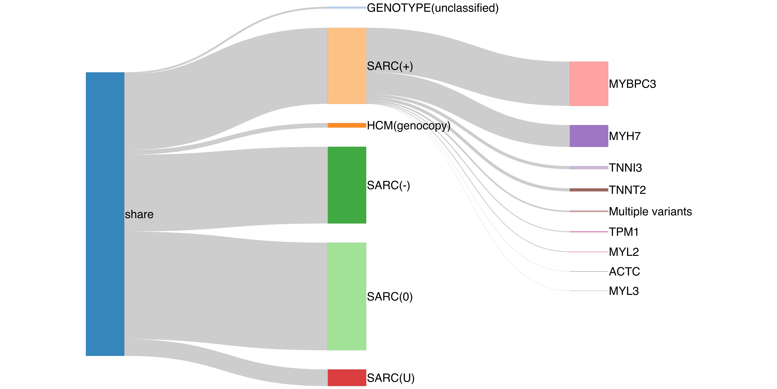
SHaRe
N = 2715
N = 1581
N = 780
N = 110
N = 2739
N = 109
N = 10,120
N = 57
N = 34
N = 29
N = 8
N = 7
Characteristics of study population

Slide 36
Common pairs (supp)

Slide 37
Common feature triplets

Slide 38


Timing

Slide 39

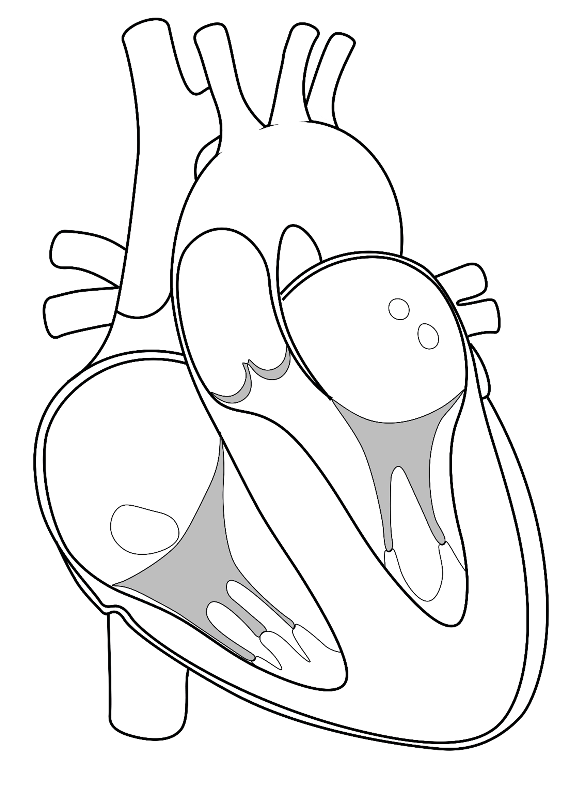



Disease trajectories
Preclinical disease
LVOT obstruction
Dyspnea
AF
Stroke
NSVT
Malignant arrhythmias
ICD
HF
Transplant
Death
Correlations and temporal patterns of CV features

Slide 41
Outcomes in SHaRe
Clinical trajectories
and outcomes

